Slide 1
Prototype Pattern
By
Narendran, S S

Slide 2
Key Items
Cloaning
Shallow / Deep Copy
Copy Factory
Copy Constructor
Copy Methods
Defensive Copying
Prototype Factory, Builders & Registry

Slide 3
Prototype Pattern
The Prototype Pattern specify the kind of objects to create using a prototypical instance, and create new objects by copying this prototype.
In Java,
Every object is itself a factory
Each class contains a clone method that creates a copy of the receiver object

Slide 4
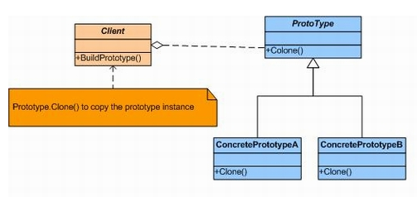
Prototype Pattern - UML

Slide 5
Prototype & Other Patterns
Sometimes creational patterns are competitors: there are cases when either Prototype or Abstract Factory could be used properly. At other times they are complementary: Abstract Factory might store a set of Prototypes from which to clone and return product objects. Abstract Factory, Builder, and Prototype can use Singleton in their implementations.
Abstract Factory classes are often implemented with Factory Methods, but they can be implemented using Prototype.
Factory Method: creation through inheritance. Prototype: creation through delegation.
Prototype doesn’t require sub classing, but it does require an “initialize” operation. Factory Method requires sub classing, but doesn’t require Initialize.
Often, designs start out using Factory Method (less complicated, more customizable, subclasses proliferate) and evolve toward Abstract Factory, Prototype, or Builder (more flexible, more complex) as the designer discovers where more flexibility is needed.
Designs that make heavy use of the Composite and Decorator patterns often can benefit from Prototype as well.

Slide 6
Prototype & Other Patterns
Prototype co-opts one instance of a class for use as a breeder of all future instances.
Prototypes are useful when object initialization is expensive, and you anticipate few variations on the initialization parameters. In this context, Prototype can avoid expensive “creation from scratch”, and support cheap cloning of a pre-initialized prototype.
Prototype is unique among the other creational patterns in that it doesn’t require a class – only an object. Object-oriented languages like Self and Omega that do away with classes completely rely on prototypes for creating new objects.

Slide 7
Pros and Cons
Pros
Reduces time in creation of Complex Objects similar to Builder pattern (Same construction process will create different objects unlike Prototype).
To Improve performance, to generate code
Hides the complexities of making new instances from the client,
Provides the option for the client to generate objects whose type is not known,
In some circumstances, copying an object can be more efficient than creating a new object.
Cons
Shallow Copying & Deep Copying should be properly understood.
A drawback to using the Prototype is that making a copy of an object can sometimes be complicated.

Slide 8
Reference
http://howtodoinjava.com/2013/01/04/prototype-design-pattern-in-java/
http://ima.udg.edu/~sellares/EINF-ES1/PrototypeToni.pdf
http://sourcemaking.com/design_patterns/prototype

